Slide 1
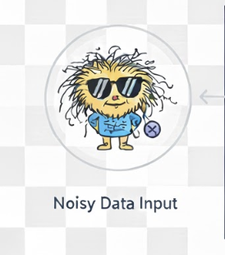

Noise robust loss functions
-Srimugunthan
Noise robust
Training

Slide 2
Agenda
Noise robust learning
What is noise robust learning? What are the different approaches?
Noise robust learning via Loss functions
What are some loss functions that aid noisy learning? How does noise robust learning work?
Results
How does noise robust loss functions perform for different noise levels and noise types

Slide 3
Agenda
01.
02.
03.
Noise robust learning
Noise robust learning via Loss functions
Results
How does noise robust loss functions perform for different noise levels and noise types
What is noise robust learning? What are the different approaches?
What are some loss functions that aid noisy learning? How does noise robust learning work?

Slide 4
Noise robust learning

Slide 5

Noisy labels
Cat or Dog?
Crowdsourced Labelling
State-of-art Automated Labelling
  Automated Labelling
    Weak-supervised learning
    Semi-supervised learning
    Transfer labelling to generate pre-annotations
Inevitable Noisy labels
human error example: tagging a song in the wrong genre
Model pre-annotation errors : errors in the automated labelling example: a sarcastic comment assigned a positive sentiment
Errors in the data collection process. Some blur images are created in the data collection process
Ambiguous instances
Types of noise
Symmetric noise: Labels are randomly flipped to other classes with equal probability.
• Asymmetric noise: Mislabeling occurs within related classes, such as categorizing a "car" as a "truck."
• Instance-dependent noise (IDN): Noise correlates with data features; for example, low-quality images may
have higher labeling errors.
• Open-set noise: Labels do not correspond to any known classes, indicating a discrepancy between training
data and real-world distributions.

Slide 6
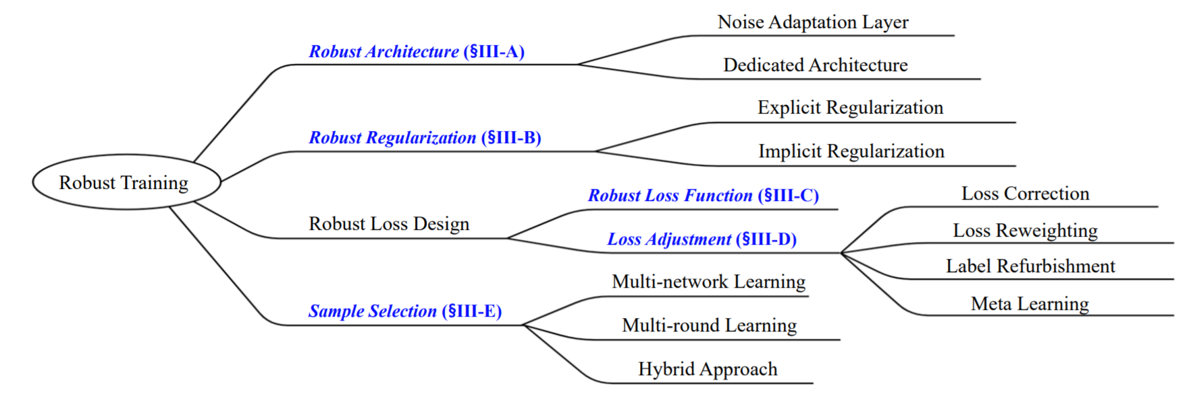
Learning despite noisy labels: Approaches
https://github.com/songhwanjun/Awesome-Noisy-Labels/tree/main

Slide 7
Noise robust learning via loss functions

Slide 8
Loss function Approach
Fundamental premise: Modify the optimization objective itself rather than the model architecture or data.
modifies the mathematical function that calculates the penalty for an error.
The goal is to bound the influence of large errors (outliers/noise) on the gradient, preventing them from dominating the optimization process.
Robust Loss Functions | Other Approaches (Reg., Sampling, Arch.)
The Objective Function $L(y, \hat{y})$ | The Model/Data $\text{Net}(\mathbf{x})$ or the Training Set $D$
Limits the gradient contribution of outliers. | Limits the model's capacity to memorize noise or removes the noisy sample from the training set.

Slide 9
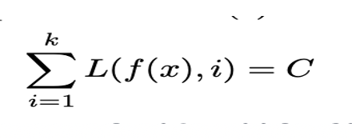
Loss function approach: How robustness is achieved
Symmetric noise
Loss function with symmetry property
Asymmetric noise
Loss function with asymmetry property : A loss function is defined as asymmetric if minimizing the weighted sum of losses (where weights correspond to label probabilities) yields the same optimal solution as minimizing the loss for the single class with the highest weight
By focusing on the dominant weight, the contribution of noisy labels (which have smaller weights) is effectively eliminated from the classifier learning process
clean-labels-domination assumption.
  operating under a "largest-takes-all" principle
Problem opportunities:
Improve the performance for symmetric noise
Improve the performance with asymmetric high noise

Slide 10
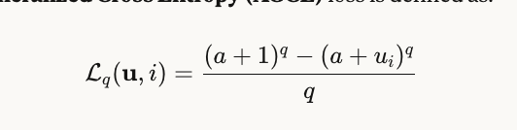
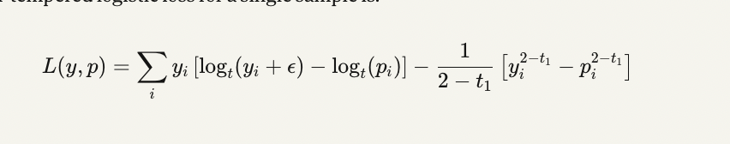

Three noise robust Loss functions
MAE
AGCE
Bi-tempered loss

Slide 11
Results

Slide 12
Methodology
MNIST dataset
Inject noise -> train dataset
Clean dataset-> test
Accuracy , f1 score metrics

Slide 13
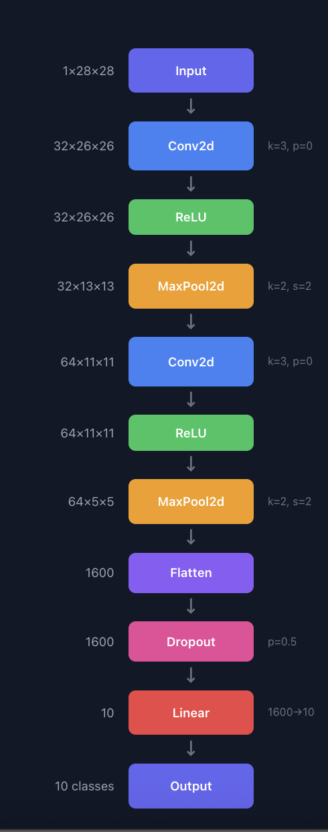
Experiment results
@40% Symmetric noise rate
Loss function | Accuracy
Cross entropy | 83%
MAE | 89%
Bi-tempered logistic loss | 85%
AGCE | 88%
Weighted ensemble | 90%
MNIST network architecture

Slide 14
Future work
Address asymmetric noise scenario.
Ideas explored:
  Use a noise translation matrix as a prior-information to model
  Sampling approaches

Slide 15
Appendix

Slide 16
Experiment results: Data set with Symmetric loss
Cross entropy Loss results
MAE Loss results
AGCE Loss results
Bitemp Loss results
Noise % | Accuracy
0% | 98%
40% | 83%
50% | 51%
60% | 16%
Noise % | Accuracy
0% | 90%
40% | 89%
50% | 54%
60% | 27%
Noise % | Accuracy
0% | 98%
40% | 88%
50% | 58%
60% | 9%
Noise % | Accuracy
0% | 92%
40% | 84%
50% | 42%

Slide 17
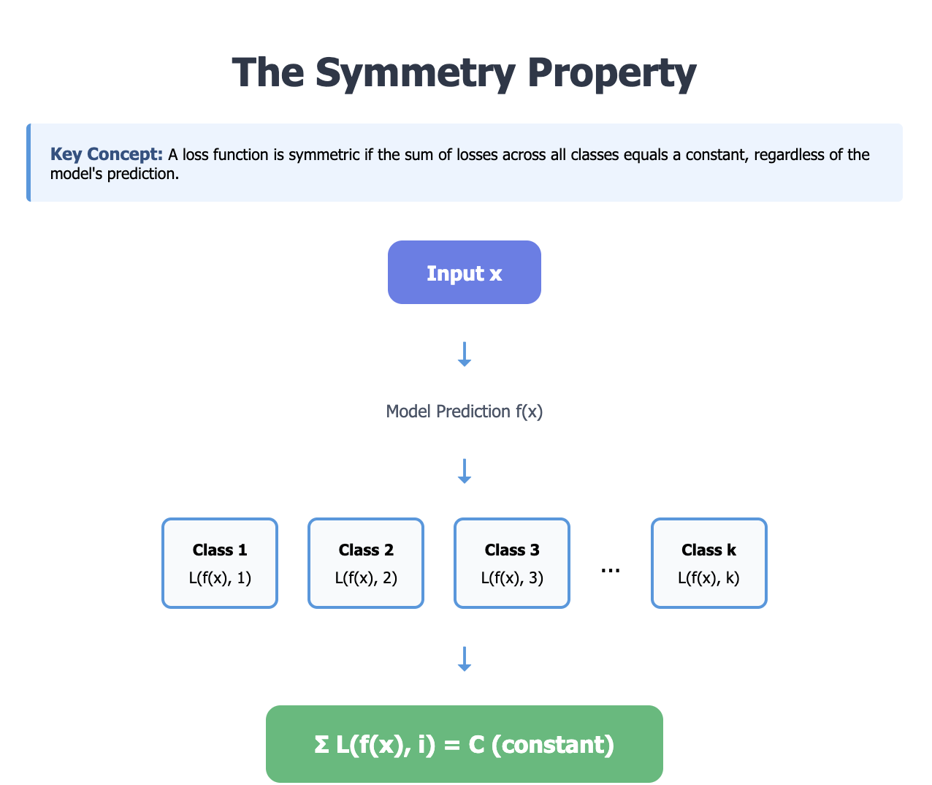
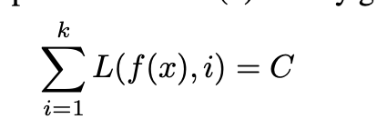
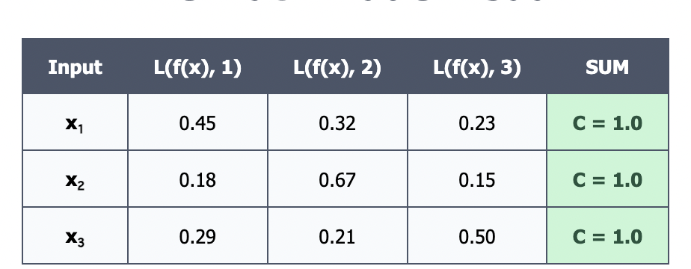
Symmetry property of loss functions
Prevents loss values to shoot up drastically in the presence of a noisy label

Slide 18
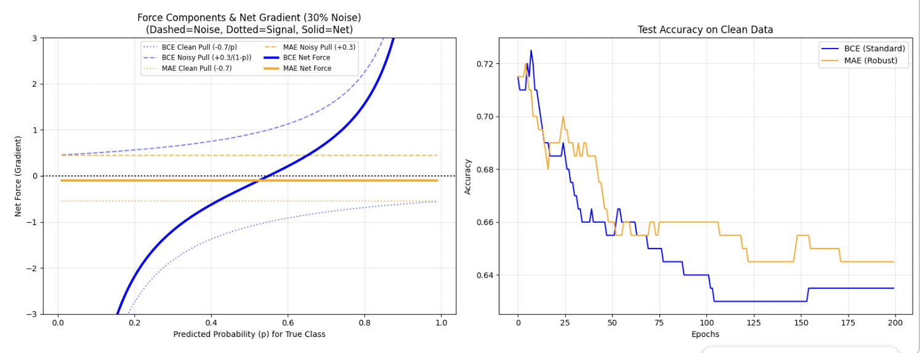
Noise robust loss functions for symmetric noise: How does it work?

Slide 19
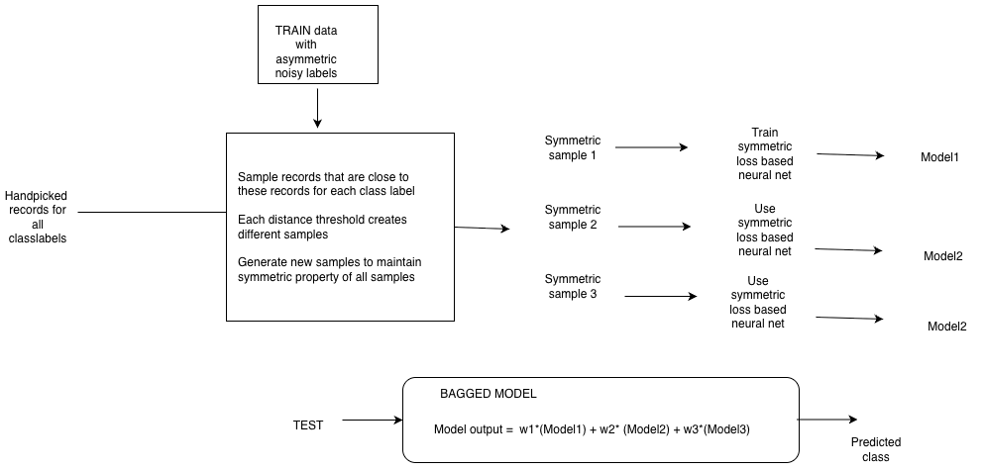
Proposed method for asymmetric noise

